Slide 1
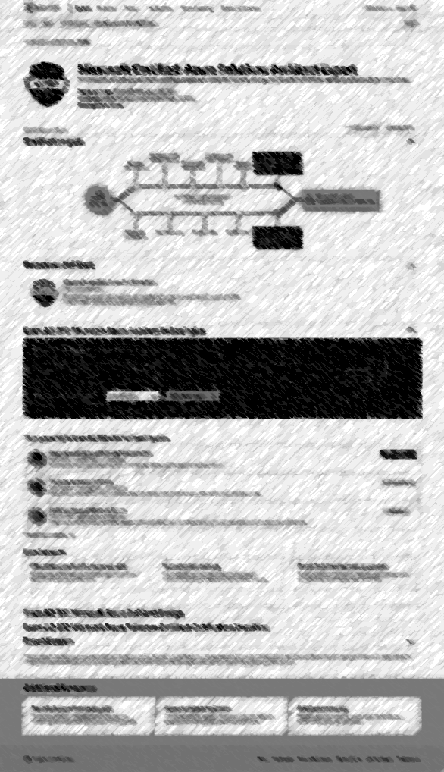
Core certification experience
User flow and design for Microsoft.com/learning
UX - WWL I DevRel

Slide 2
What we will cover
Overview
Goals
Context
User flows – Decision tree
Design – Content & layout
Design – Prototype
Appendix
Competitive analysis
User study
Transitional designs
Related items are currently underway but not ready to present.
ILT courses
Partners
Dashboard/Profile
Homepage & entry points
See Appendix for detailed list of co-UX work items

Slide 3
Goals for the core certification experience
Simple path for certification
Provide a path that is sequential
Provide a high-level representation of the path
Map learning paths directly to certifications
Integrate partners/instructor-led training
Simple path for job roles
Align job roles to certifications and learning paths
Surface tasks to becoming certified
Learning assets and resources in context to certifications

Slide 4
Context - Audience
This context setting helped us focus on the core experience.
Additional personas, flows and entries will refine the experience and are outlined in the UX backlog.

Slide 5
Context - Phasing
Transitional Experience
Part of the Microsoft.com/learning migration plan
Design in Appendix
Mar-Jun
Purpose
Provide customers with a role-based
certification experience now.
Easier transition for the learner.
Gain insights and data to influence the future experience.
Future Experience
Microsoft.com/learn
Jun+
Purpose
Consolidate preparation and certification into one experience.
Create a long-term experience that can improve for customers.

Slide 6
Timeline: Core certification experience
Implement Transitional exp. on /Learning
March
Transitional exp.
data measuring
March-May
Launch Future exp.
on Learn
May
Initial user study
of Future exp.
Week 2/25
Review Future exp.
March 4
Future exp. design handoff to DevRel
March
Iterate & test Future exp.
Ongoing
Working with Michael Sullivan on workback schedule for all UX items
Timeline is consistent with the all-up migration timing

Slide 7
User flows

Slide 8
Current AWS certification flow aws.amazon.com/certification

Slide 9
Current Microsoft certification flow microsoft.com/learning

Slide 10
Future Microsoft certification flow microsoft.com/learn

Slide 11
AWS and Microsoft Comparison
AWS certification flow
Future Microsoft certification flow

Slide 12
Designs – Content & layout
Review

Slide 13
AWS & Microsoft content & layout comparison
Notes
Bias for action
Allow users to quickly navigate to products and make a decision
User testing resulted in seeing people skim the Story/Messaging and immediately scroll to the Products

Slide 14
AWS content & layout (wireframes)

Slide 15
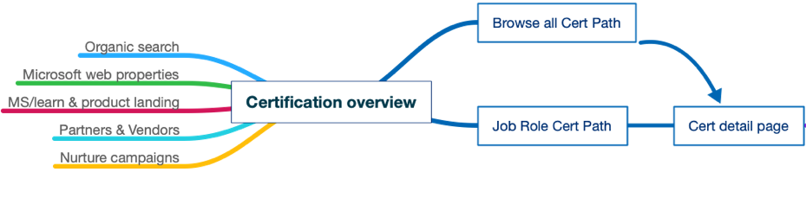
Scope – Core certification pages
Pages within the Future Microsoft.com/learn core certification UX flow
Certification overview
Job roles
Browse all certification paths
Certification path (cert details)
Exam
Diagram represents how users may inbound into Certification Overview page “front door” and how we are providing different ways users will explore certifications.

Slide 16
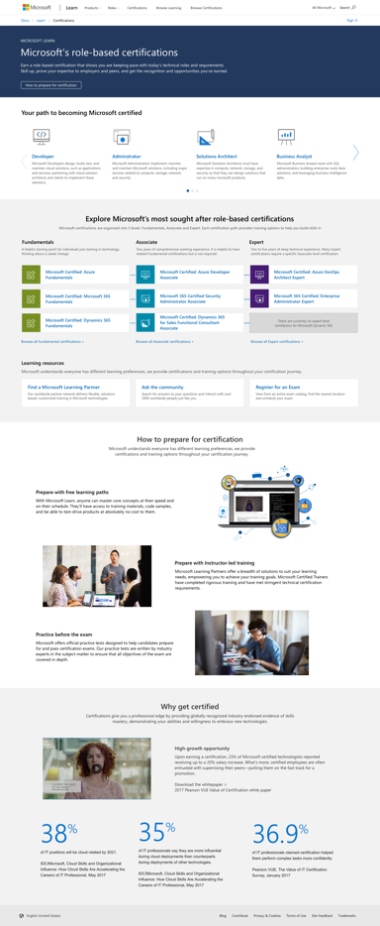
Certification overview
Introduction
And CTA to How to & Why to...
Job roles & specialties
Certification structure
Certification hierarchy
Featured certification paths
Popular, strategic, recommended, new
Learning resources
Shortcuts to learning partners,
community, and exam registration
How to & Why to...
Certification value props

Slide 17
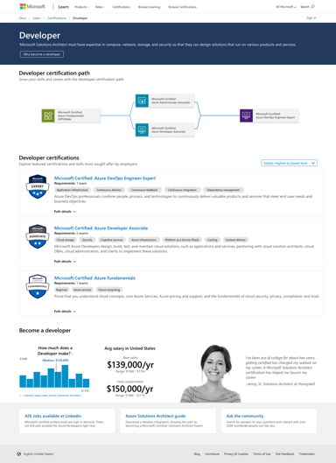
Job role
Introduction
And CTA to “Become a ….” (bottom of the page)
Job role certification path
Certifications
Based on job role +
Sorting by level
Certification
Badge, title, skills meta, description, call to action, path preview
Become a {job role}
Linkedin assets, salary, testimonials
Job resources
Job listings, docs resources,
community

Slide 18
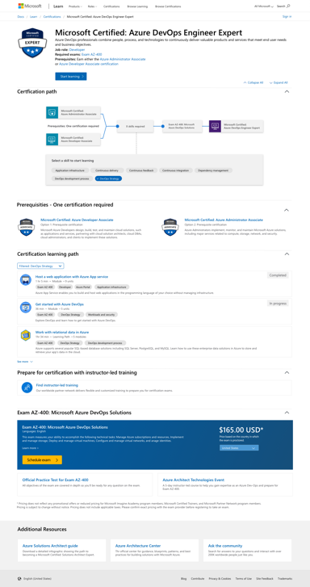
Certification path
Introduction Requirements, metadata, badge, shortcut to first learning path
Certification path
Visualize prerequisites, skills, exams
Recommended Start
Fundamentals and/or Prerequisites
Instructor-led training
Link to filtered course lists
Learning paths
Badge, time, skills, description
Exam(s)
Registration
Practice tests
docs.microsoft.com resources
Certification resources
Infographics/Diagrams
Documents
Community

Slide 19
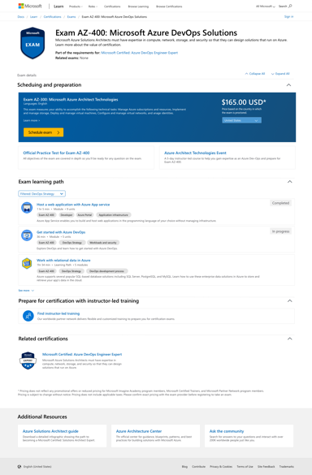
Exam
Introduction Requirements,
metadata, badge
Exam
metadata, schedule
Learning paths
Badge, time, skills, description
Exam resources
Practice tests
docs.microsoft.com resources
Instructor-led training
Link to filtered course lists
Related certifications
Certifications this exam validates
Related Resources
Infographics/Diagrams
Documents
Community

Slide 20
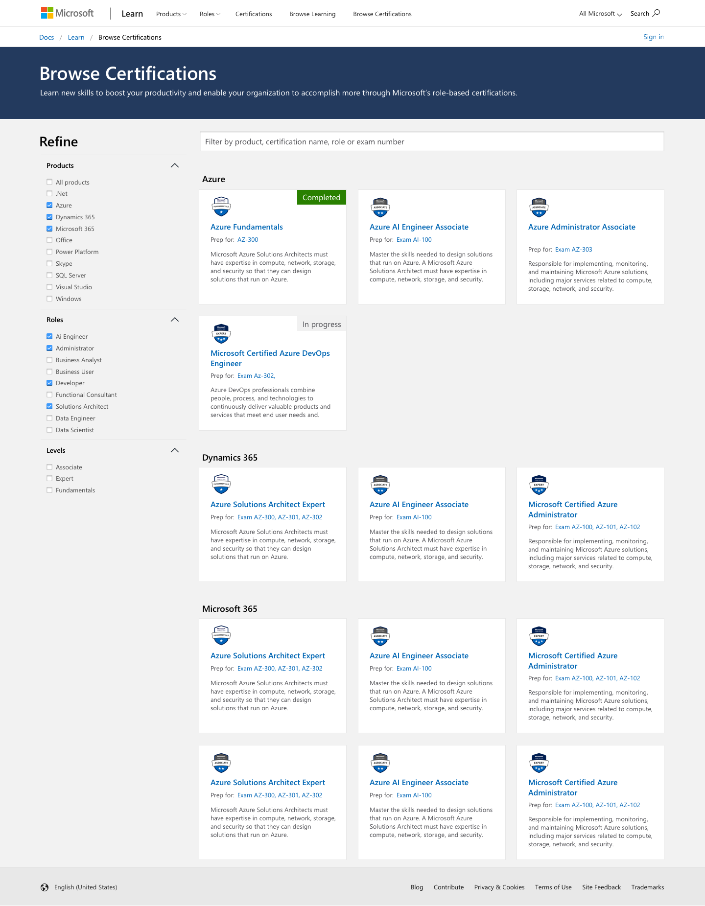
Browse
Filtering
Technology
Job role
Level
Certification paths
Sorted by filters

Slide 21
Click through prototype
https://aka.ms/certsonlearn

Slide 22
Appendix

Slide 23
Competitive analysis
AWS, Google, and Trailhead
Qualitative feedback from user study and design research

Slide 24
Feature comparison for phase 1
 | AWS | Google | Trailhead | Microsoft Current | Microsoft Future
Certification path diagram | X |  |  |  | X
Free learning content directly on certification page |  | X | X |  | X
Persistent navigation |  | X | X | X | X
Certifications discoverable by job role | X | X | X | X | X
Clear calls to action | X | X | X |  | X
Certifications are easily discoverable in larger ecosystem |  |  | X | X | X
Communicate skills/knowledge validated by each certification |  | X |  | X | X

Slide 25
AWS
Notes
Their cert program is a lot less “simple“ with Machine Learning, AWS Media, and Storage. There isn’t a cohesive story, these 3 break the “role-based model”
Messaging is clear and CTAs are direct
Certification diagrams are not interactive or accessible
Endlessly opens new browser tabs
Misalignment of certifications and training filter taxonomy/terms
Decisions are not persisted through the experience, especially in aws.training (I must reselect at every step)

Slide 26


Google Cloud
Notes
Clear breakdown of certification hierarchy (it’s a flat structure)
Clear definition of skills that align to certification
Simple communication of training options for certification
Developer and Cloud certifications are separate experiences and communication is different
Very simple value props for certification (maybe too simple)

Slide 27
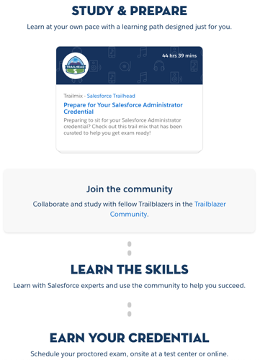
Trailhead
Notes
Interchanges the words “Certification” and “Exams” without explanation
Career paths (job role) are clearly explained and validated with statistics
Classes and workshops are exposed through downloadable PDFs only
Promotes community to help individuals prepare
Confusing hierarchy – “Superbadges” and “Certifications”

Slide 28
What Microsoft is/will be doing better
Notes
Represent the journey/path simply and make it actionable
Deliver flows based on what users need (job-roles & certs)
Clearly define the skills that align to certification (already doing)
Fast track to prep for cert “Start here”
Provide clear and consistent messaging throughout the experience
Don’t allow the story/message to impede the ability for a user to make a decision

Slide 29
User Study
Conducted by Developer Relations Design Team

Slide 30
Highlights from user study
All users were very positive about having a graphic representation of the certification path and wanted it to be shown as default in either job-role page or cert-path page. There is an expectation that the certification path graphic is interactive.
Certification path page - Potential to be used as a learning guidance (syllabus). Show what entails to be a {Solutions Architect} by providing a clear learning guidance/syllabus. Those who aren’t interested in certifications still use the cert-path page to guide their learning.
Certification overview page - Potential certification seekers found the testimonial and "Why get certified?” on the certification overview very helpful.
Certification overview page - Those who are already working toward certification found the “Explore Microsoft’s most sought-after certifications” table most valuable. They wanted to see the certifications they already passed marked on the table.
Certification path page - Users wanted to know how close they are to being job-, cert-, or exam-ready. How can we leverage user data and account linking to highlight readiness?
Participants
Job Title | Interest in Certification
Solutions Architect | Potential seeker
System Analyst | Have M365; Working on Azure
Business Analyst | Had M365; No future interest
System Architect | Taking Azure cert soon
IT Manager | Interest for his team, not himself
Consultant | No interest
Notes:
Detailed results
https://microsoft.sharepoint.com/:w:/t/docsmicrosoftcom/ERIpfRGjmWpPoBwoySe1Pk8BrKWSsVnV_mxYTS0kcQ7EJQ?rtime=AnA4eZ-e1kg

Slide 31
Transitional experience
Part of phase 2 of the migration plan: simplification and transition Microsoft.com/learning (Mar-Jun)
Purpose
Provide customers with a role-based certification experience now.
Easier transition for the learner.
Gain insights to influence the future experience.

Slide 32
Transitional Microsoft certification flow (Microsoft.com/learning)
Interim Microsoft certification flow
Future Microsoft certification flow

Slide 33
Design & Prototype
Certification Overview
Browse certifications
Certification path
Exam
Homepage
Unchanged relative to
certification experience
Prototype URL
https://xd.adobe.com/view/fedbfbe7-1f71-4352-67a3-857ebc25dfb5-88ea/?fullscreen

Slide 34
Process
Deliver a Transitional experience on Microsoft.com/learning
Maintain parody with Future exp. (as much as possible)
Develop content with GTM and brand teams
Gain insights in the Transitional experience to influence the Future experience
Measure usage data
User testing
Currently creating a test plan
Currently organizing a user panel
Integrate insights gained into Future experience
Release the Future experience on Microsoft.com/learn
Iterate on Future experience based on insights

Slide 35
Co-UX work items

Slide 36
Co-UX Goals and Work Items Overview
Phase 0 Core certification experience Landing pages Certification and exam details Roles pages Browse Learn profile Certifications MSA and AAD linking Entry points Learn Home Learning paths Others |  | Phase 1 Learning partner pages Reporting dashboards Custom playlists Learn for Orgs |  | Phase 2/3 Course page Exam scheduling Labs Video support GTM
Phase 0 & 1 items are currently in the UX backlog

Slide 37
MS Learn Workstreams Assent
The following table highlights the UX-related workstreams we are working on with the DevRel UX team.
Agree to scope and timing | Details/timeline pending
Core certification experience (landing pages, detail pages, role-based, browse) Learn profile (Cert dashboard, MPN dashboard, account linking) Entry points (MS Learn home, learning paths, etc.) Courses page Learning partners page Reporting/metrics dashboards Learn for Orgs Custom playlists (Enterprise packaged content) | Microsoft-hosted exam scheduling Labs Native video support GTM support (campaign landing pages, etc.)

